Slide 1

Spreadsheet Project
IT
TICKET ANALYSIS
By Anushil Kumar Gautam
29th Jan 2025

Slide 2

Agenda
Problem Statement
Data Description
Objective Key Metrics and Visualizations
Insights and Recommendations

Slide 3
Problem Statement
The objective is to analyze the IT support ticket management system to understand the performance of IT agents, the efficiency of ticket resolution, and the satisfaction levels of employees. The analysis aims to identify high and low performers among IT agents, assess the overall effectiveness of the team, and pinpoint areas for improvement in the ticket resolution process. The ultimate goal is to make informed staffing decisions, including hiring, firing, and training, to enhance overall service quality and team performance.
Goal:
Informed staffing decisions
Improved training
And software efficiency.
3

Slide 4
Data Overview
Total Tickets: 97498
Tickets Sheet : Contains information about IT support tickets. Tickets Sheet: Contains information about IT support tickets.
ID: Unique identifier for the ticket.
Ticket Fecha: Date of the ticket.
Employee ID: ID of the employee who raised the ticket.
Agent ID: ID of the agent assigned to the ticket.
Request Category: Category of the request (e.g., Login Access, System, Software).
Issue Type: Type of issue (e.g., IT Error, IT Request).
Severity: Severity of the issue.
Priority: Priority level of the issue.
Resolution Time (Days): Time taken to resolve the ticket.
Satisfaction Rate: Satisfaction rate provided by the employee (1-5 scale).
IT Agents Sheet : Contains information about IT agents.
Agent ID: Unique identifier for the agent.
Full Name: Full name of the agent.
Email: Email address of the agent.
Year of Birth: Year the agent was born.
Month of Birth: Month the agent was born.
Day of Birth: Day the agent was born.
4

Slide 5
Metric 1: “Ticket Count by Time (Year)”
The ticket volume has shown consistent growth over the years:
In 2016, 13,051 tickets were recorded.
The number increased to 14,915 in 2017 and further to 18,954 in 2018.
In 2019, the count rose to 21,490, and by 2020, it reached its highest at 29,088.
This reflects a significant upward trend, with ticket volumes more than doubling from 2016 to 2020.
Ticket Count
Time(Year)

Slide 6
Metric 2: “Tickets Distribution By Request Category”
The distribution of tickets across request categories highlights key areas of support demand:
System-related requests dominate with 39,002 tickets, indicating a significant focus on infrastructure issues.
Login Access is the second-highest category with 29,193 tickets, reflecting frequent challenges with account access or authentication.
Software issues account for 19,570 tickets, emphasizing the need for application support.
Hardware requests are the least frequent, with 9,733 tickets, suggesting fewer physical device-related issues compared to other categories.
This breakdown suggests that most support resources are directed toward system stability and access management.

Slide 7
Metric 3: “Average Satisfaction Rate By Time”
The average satisfaction rate has shown a gradual improvement over the years:
In 2016, the satisfaction rate started at 4.0.
It increased slightly to 4.1 in 2017 and remained consistent through 2018 and 2019.
By 2020, it rose further to 4.2, marking a steady upward trend in customer satisfaction over the five-year period.
This indicates a positive progression in meeting user expectations and improving service quality.
Avg. Satisfaction Rate
Time(Year)

Slide 8
Metric 4: “Ticket Count By Severity Level”
The distribution of tickets by severity level reveals the following trends:
Severity 2 tickets dominate with 88,656, accounting for the vast majority, indicating that most issues are of moderate priority.
Severity 3 tickets total 4,836, while Severity 4 tickets stand at 1,392, representing lower-priority issues.
Severity 1 tickets, which are likely high-priority, amount to 2,258, and Severity 0 tickets, possibly the most critical, are the least frequent at 356.
This breakdown suggests that most tickets are of medium priority, with critical issues forming a small proportion of the total.
Ticket Count
Severity Level

Slide 9
Metric 5: “Ticket Count By Priority”
The distribution of tickets by severity level reveals the following trends:
Severity 2 tickets dominate with 88,656, accounting for the vast majority, indicating that most issues are of moderate priority.
Severity 3 tickets total 4,836, while Severity 4 tickets stand at 1,392, representing lower-priority issues.
Severity 1 tickets, which are likely high-priority, amount to 2,258, and Severity 0 tickets, possibly the most critical, are the least frequent at 356.
This breakdown suggests that most tickets are of medium priority, with critical issues forming a small proportion of the total.

Slide 10
Metric 6: “Average Resolution Time by Request Category Quarterly”
The average resolution time (in days) by request category and quarter highlights the following trends:
Hardware: Takes the longest to resolve, averaging 7.5–7.7 days consistently across all quarters.
Login Access: Has the shortest resolution time at just 0.3 days for every quarter, indicating a highly efficient resolution process.
Software: Resolution times are steady, averaging 5.2–5.3 days, with minimal variation between quarters.
System: Consistently resolved in 6.6 days throughout the year, showing stable performance in this category.
This suggests that login access issues are prioritized and resolved quickly, while hardware issues require more time, possibly due to physical repair or replacement processes. Other categories show consistent performance across quarters.
Avg. Resolution Time
Request Category

Slide 11
Metric 7: “Satisfaction Rate By Age-groups”
Looking at the satisfaction rates across the different age groups, here’s an analysis of the trends:
25-29: Satisfaction rate of 4.2, indicating high satisfaction.
30-34: Slight drop to 4.1, minor decrease in satisfaction.
35-39: Rebounds to 4.2, suggesting stability and contentment.
40-44: Drops to 3.9, lowest satisfaction, possibly due to life pressures.
45-49: Increases to 4.4, highest satisfaction, possibly due to career and personal stability.
50-55: Drops slightly to 4.2, maintaining a high but stable level of satisfaction.
This highlights the general trend of fluctuating satisfaction based on life stages.
Avg. Satisfaction Level
Age Group

Slide 12
Metric 8: “Distribution of tickets based on satisfaction”
Satisfaction 1: 9,907 tickets with the lowest satisfaction.
Satisfaction 2: 1,977 tickets with below-average satisfaction.
Satisfaction 3: 7,282 tickets, indicating neutral satisfaction.
Satisfaction 4: 27,562 tickets with high satisfaction.
Satisfaction 5: 50,770 tickets with the highest satisfaction.
Most tickets fall in the higher satisfaction ranges (4 and 5).
Ticket Count
Satisfaction Level

Slide 13
Metric 9: “Distribution Of Tickets Based On Resolution Time”
Resolution Time 0: 25,071 tickets resolved instantly, showing a large number of quick resolutions.
Resolution Time 1-5: Between 9,277 and 8,789 tickets resolved in 1 to 5 time units, indicating a moderate resolution rate.
Resolution Time 6-10: Between 7,802 and 3,739 tickets resolved in 6 to 10 time units, showing a decrease in the number of tickets as resolution time increases.
Resolution Time 11-15: Between 1,732 and 1,360 tickets, with a further decline in the number of tickets resolved.
Resolution Time 16-21: Less than 2,000 tickets in this range, with only 2 tickets taking 20 and 21 time units, indicating very few long resolution times.
In summary, the majority of tickets are resolved quickly (within 0-5 units of time), with progressively fewer tickets being resolved as the resolution time increases.
Ticket Count
Resolution Time

Slide 14
Conclusion on Key Metric
Key Metrics
Count:
Total number of tickets handled by the agent.
Higher ticket counts could indicate high productivity. Consider whether the agent is meeting the workload expectation.
Resolution Time:
Average and median resolution times should ideally align with organizational benchmarks.
A high maximum resolution time could indicate inefficiency in handling certain cases.
Satisfaction Rate:
Customer satisfaction rate is a critical metric.
A satisfaction rate below a defined threshold (e.g., 3.5 out of 5) may be unacceptable.

Slide 15
Conclusion on Key Metric (contd.)
Decision Considerations
Focus on Trends:
If the agent's performance consistently skews towards the min or below average values for all metrics (e.g., low satisfaction, high resolution time), this may indicate a need for improvement or dismissal.
Satisfaction as a Priority:
Since customer satisfaction (median 4.2, min 3.0) is vital, consider firing the agent if their consistent satisfaction rate is closer to the minimum (3.0).
Low Ticket Volume with Poor Metrics:
If the agent has a low count of tickets and still shows poor resolution time or satisfaction rates, this might justify dismissal.
Compare with team averages to confirm underperformance.
Balanced Approach:
Provide training or coaching opportunities for agents who are borderline performers, especially if metrics like median resolution time (4.6) and average satisfaction rate (4.1) aren't far off from expectations.

Slide 16
Recommendations
Focus on Hardware and Systems:
Hardware and system-related tickets take the longest to resolve and impact satisfaction significantly. Prioritize investment in modernizing these areas.
Leverage Automation:
Introduce AI-driven tools for ticket classification, triage, and resolution suggestions to reduce manual workload and speed up response times.
Employee Training:
Train employees to handle software and system tools more effectively to reduce errors that lead to tickets.
Proactive Monitoring and Maintenance:
Invest in monitoring tools that pre-emptively detect and resolve hardware/system issues before employees report them.

Slide 17
Recommendations (Contd.)
Feedback Mechanism:
Actively collect feedback from employees on new technology implementations to fine-tune investments and ensure alignment with their needs.
Leverage Efficiency for Smaller Age Groups:
The 47–48 and 53–55 age groups exhibit good satisfaction rates and quick resolution times. Analyse what works well for these groups (e.g., types of tickets, communication strategies) and replicate these practices for other demographics.
Resource Allocation Based on Ticket Volume:
Assign more support resources to the 41–44 age group or redistribute workloads to ensure quicker response and resolution times for high-ticket-volume age groups.

Slide 18
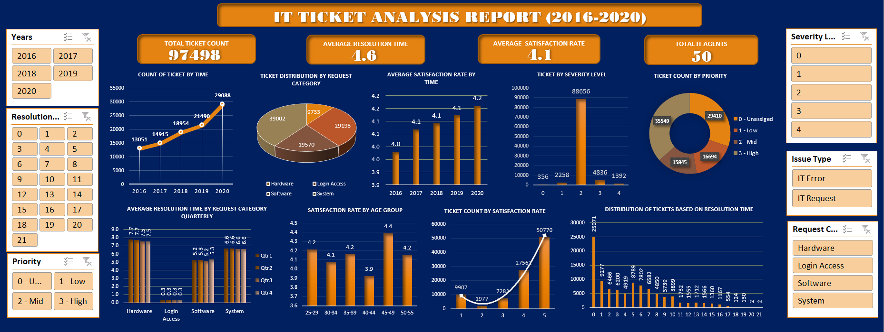
Dashboard

Slide 19
Thank You!!
IT
TICKET ANALYSIS
By Anushil Kumar Gautam
29th Jan 2025

